Slide 1
Single Cycle CPU Design
Morteza Nikooghadam
Chapter 7

Slide 2
Big Picture: Where are We Now?
Five classic components of a computer
Today’s topic: design a single cycle processor
Processor
Input
Control
Memory
Datapath
Output
machine
design
arithmetic (Ch 3)
inst. set design (Ch 2)
technology
Single-cycle CPU
Notes:
Before we go any further, let’s step back for a second and take a look at the big picture.
All computer consist of five components: (1) Input and (2) output devices. (3) The Memory System. And the (4) Control and (5) Datapath of the Processor.
Today’s lecture covers the datapath design.
In Friday’s lecture, we will show you how to design the processor’s control unit.
+1 = 5 min. (X:45)

Slide 3
The Performance Perspective
Performance of a machine is determined by:
  Instruction count
  Clock cycle time
  Clock cycles per instruction
Processor design (datapath and control) will determine:
  Clock cycle time
  Clock cycles per instruction
Today: single cycle processor
  Advantage: one clock cycle per instruction
  Disadvantage: long cycle time
CPI
Inst. Count
Cycle Time
Single-cycle CPU
Notes:
This slide shows how the next two lectures fit into the overall performance picture.
Recalled from one of your earlier lectures that the performance of a machine is determined by 3 factors: (a) Instruction count, (b) Clock cycle time, and (c) Clock cycles per instruction.
Instruction count is controlled by the Instruction Set Architecture and the compiler design so the computer engineer has very little control over it (Instruction Count).
What you as a computer engineer can control, while you are designing a processor, are the Clock Cycle Time and Instruction Count per cycle.
More specifically, in the next two lectures, you will be designing a single cycle processor which by definition takes one clock cycle to execute every instruction.
The disadvantage of this single cycle processor design is that it has a long cycle time.
+2 = 7 min. (X:47)

Slide 4
How to Design a Processor
1. Analyze instruction set ⇒ datapath requirements
  Meaning of each instruction given by register transfers
  Datapath must include storage element for ISA registers (possibly more)
  Datapath must support each register transfer
2. Select set of datapath components and establish clocking methodology
3. Assemble datapath meeting the requirements
4. Analyze implementation of each instruction to determine setting of control points that effects the register transfer
5. Assemble the control logic
Single-cycle CPU

Slide 5
MIPS Instruction Formats
All MIPS instructions are 32 bits long; 3 instruct. formats:
  R-type
  I-type
  J-type
The different fields are:
  op: operation of the instruction
  rs, rt, rd: the source and destination register specifiers
  shamt: shift amount
  funct: selects the variant of the operation in the “op” field
  address / immediate: address offset or immediate value
  target address: target address of the jump instruction
31
26
21
16
11
6
0
op
rs
rt
rd
shamt
funct
6 bits
5 bits
5 bits
5 bits
5 bits
6 bits
31
26
21
16
0
op
rs
rt
immediate
6 bits
5 bits
5 bits
16 bits
31
26
0
op
target address
6 bits
26 bits
Single-cycle CPU
Notes:
One of the most important thing you need to know before you start designing a processor is how the instructions look like.
Or in more technical term, you need to know the instruction format. One good thing about the MIPS instruction set is that it is very simple.
First of all, all MIPS instructions are 32 bits long and there are only three instruction formats: (a) R-type, (b) I-type, and (c) J-type.
The different fields of the R-type instructions are:
(a) OP specifies the operation of the instruction.
(b) Rs, Rt, and Rd are the source and destination register specifiers.
(c) Shamt specifies the amount you need to shift for the shift instructions.
(d) Funct selects the variant of the operation specified in the “op” field.
For the I-type instruction, bits 0 to 15 are used as an immediate field. I will show you how this immediate field is used differently by different instructions.
Finally for the J-type instruction, bits 0 to 25 become the target address of the jump.
+3 = 10 min. (X:50)

Slide 6
Step 1a: The MIPS-lite Subset
ADD, SUB, AND, OR
  add rd, rs, rt
  sub rd, rs, rt
  and rd, rs,rt
  or rd,rs,rt
LOAD and STORE Word
  lw rt, rs, imm16
  sw rt, rs, imm16
BRANCH:
  beq rs, rt, imm16
31
26
21
16
11
6
0
op
rs
rt
rd
shamt
funct
6 bits
5 bits
5 bits
5 bits
5 bits
6 bits
31
26
21
16
0
op
rs
rt
immediate
6 bits
5 bits
5 bits
16 bits
31
26
21
16
0
op
rs
rt
immediate
6 bits
5 bits
5 bits
16 bits
Single-cycle CPU
Notes:
In today’s lecture, I will show you how to implement the following subset of MIPS instructions: add, subtract, or immediate, load, store, branch, and the jump instruction.
The Add and Subtract instructions use the R format. The Op together with the Func fields together specified all the different kinds of add and subtract instructions.
Rs and Rt specifies the source registers. And the Rd field specifies the destination register.
The Or immediate instruction uses the I format. It only uses one source register, Rs. The other operand comes from the immediate field. The Rt field is used to specified the destination register. (Note that dest is the Rt field!)
Both the load and store instructions use the I format and both add the Rs and the immediate filed together to from the memory address.
The difference is that the load instruction will load the data from memory into Rt while the store instruction will store the data in Rt into the memory.
The branch on equal instruction also uses the I format. Here Rs and Rt are used to specified the registers we need to compare.
If these two registers are equal, we will branch to a location offset by the immediate field.
Finally, the jump instruction uses the J format and always causes the program to jump to a memory location specified in the address field.
I know I went over this rather quickly and you may have missed something. But don’t worry, this is just an overview. You will keep seeing these (point to the format) all day today.
+3 = 13 min. (X:53)

Slide 7
Register Transfer Language
RTL gives the meaning of the instructions
First step is to fetch the instruction from memory
op | rs | rt | rd | shamt | funct = MEM[ PC ]
op | rs | rt | Imm16 = MEM[ PC ]
inst Register Transfers
ADD R[rd] <– R[rs] + R[rt]; PC <– PC + 4
SUB R[rd] <– R[rs] – R[rt]; PC <– PC + 4
OR R[rd] <– R[rs] | R[rt]; PC <– PC + 4
LOAD R[rt] <– MEM[ R[rs] + sign_ext(Imm16)]; PC <– PC + 4
STORE MEM[ R[rs] + sign_ext(Imm16) ] <– R[rt]; PC <– PC + 4
BEQ if ( R[rs] == R[rt] ) then PC <– PC + sign_ext(Imm16)] || 00
else PC <– PC + 4
Single-cycle CPU

Slide 8
Step 1b: Requirements of Instr. Set
Memory
  Instruction & data
Registers (32 x 32)
  Read RS
  Read RT
  Write RT or RD
Extender
Add and Sub register or extended immediate
PC
  Add 4 or extended immediate to PC
Single-cycle CPU

Slide 9
Step 2: Components of Datapath
Combinational elements
Storage elements
  Clocking methodology
Single-cycle CPU

Slide 10
Abstract/Simplified View of Datapath
D
a
t
a
R
e
g
i
s
t
e
r
#
P
C
A
d
d
r
e
s
s
I
n
s
t
r
u
c
t
i
o
n
R
e
g
i
s
t
e
r
s
A
L
U
A
d
d
r
e
s
s
I
n
s
t
r
u
c
t
i
o
n
R
e
g
i
s
t
e
r
#
m
e
m
o
r
y
D
a
t
a
R
e
g
i
s
t
e
r
#
m
e
m
o
r
y
D
a
t
a
Two types of functional units:
  Elements that operate on data values (combinational)
  Elements that contain state (sequential)
Single-cycle CPU

Slide 11
Combinational Logic Elements
CarryIn
Adder
MUX
ALU
A
Basic building blocks
32
Adder
Sum
32
B
Carry
32
Select
A
32
MUX
Y
32
B
32
OP
A
32
ALU
Result
32
B
32
Single-cycle CPU
Notes:
Based on the Register Transfer Language examples we have so far, we know we will need the following combinational logic elements.
We will need an adder to update the program counter.
A MUX to select the results.
And finally, an ALU to do various arithmetic and logic operation.
+1 = 30 min. (Y:10)

Slide 12
State Elements: Review
Unclocked vs. Clocked
Clocks used in synchronous logic
  When should an element that contains state be updated?
falling edge
cycle time
rising edge
Single-cycle CPU

Slide 13
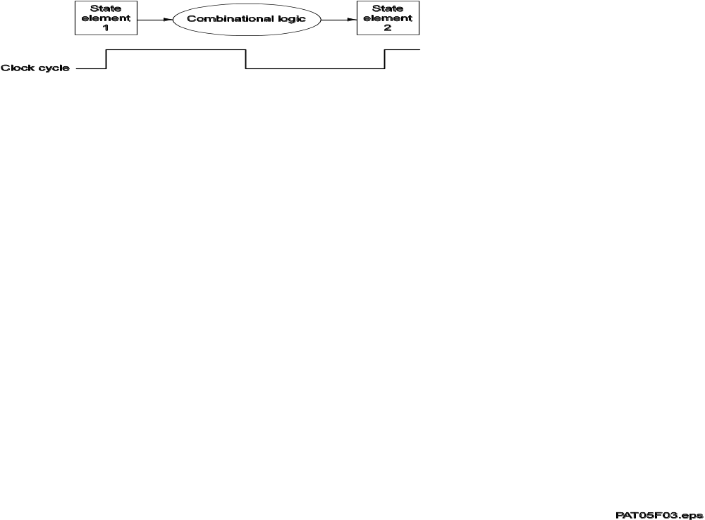
Relationship between state elements and combinatorial circuits
State elements change only on the clock edge
They provide stable outputs for the combinatorial logic
The clock period must be long enough for the combinatorial circuit to stabilize
Single-cycle CPU

Slide 14
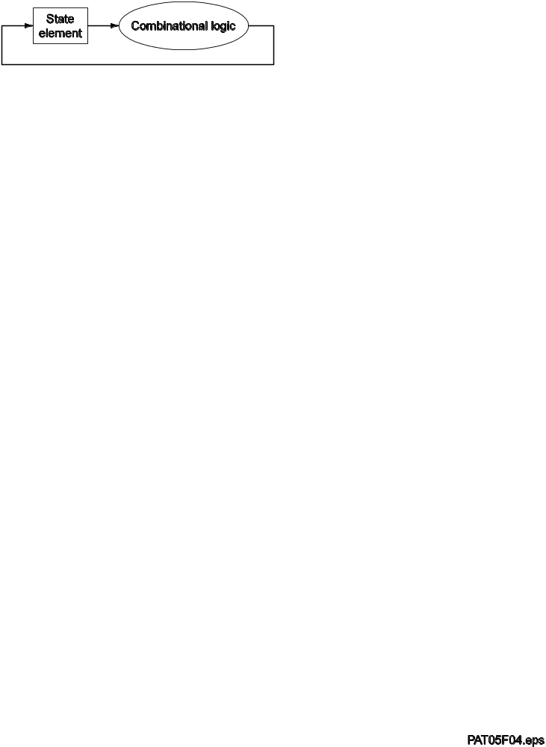
Absence of race conditions
Read and write can be done in the same cycle (clock period long enough)
Single-cycle CPU

Slide 15
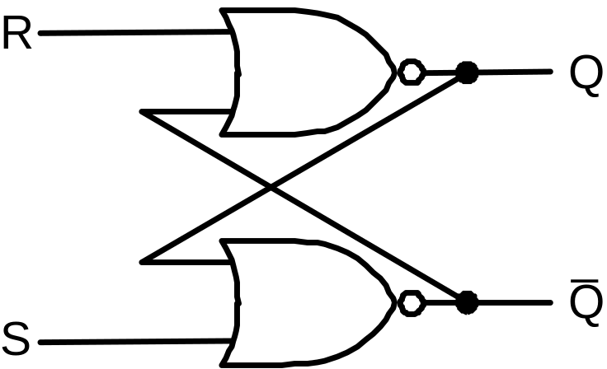
An Unclocked State Element
The set-reset latch
  Output depends on present inputs and also on past inputs
Single-cycle CPU

Slide 16
Latches and Flip-flops
Output is equal to the stored value inside the element
  Don't need to ask for permission to look at the value
Change of state (value) is based on the clock
Latches: whenever the inputs change, and the clock is asserted
Flip-flop: state changes only on a clock edge
  Edge-triggered methodology
Details: Appendix B.8
A clocking methodology defines when signals can be read and written
— wouldn't want to read a signal at the same time it was being written
Single-cycle CPU

Slide 17
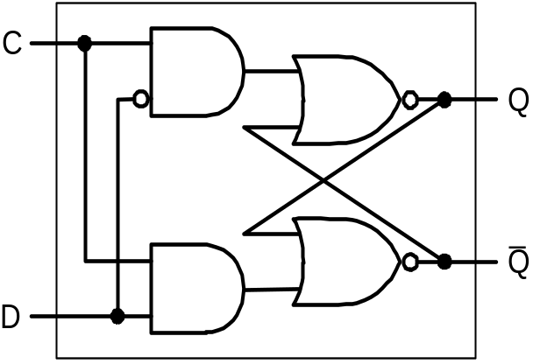
D-latch
Two inputs:
  The data value to be stored (D)
  The clock signal (C) indicating when to read & store D
Two outputs:
  The value of the internal state (Q) and its complement
D
C
Q
Single-cycle CPU

Slide 18
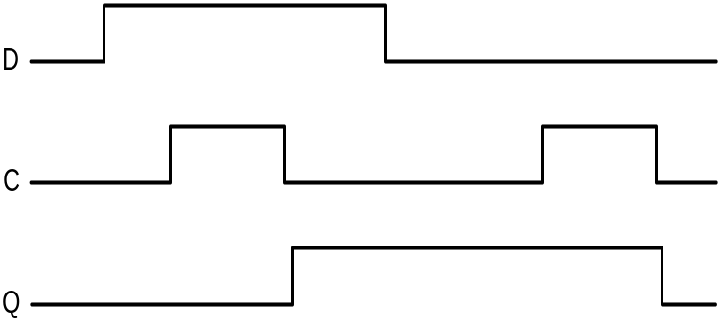
D Flip-flop
Output changes only on the clock edge
D
D
D
Q
D
D
Q
Q
l
a
t
c
h
l
a
t
c
h
_
_
C
C
Q
Q
C
Single-cycle CPU

Slide 19
Our Implementation
An edge triggered methodology
Typical execution:
  Read contents of some state elements
  Send values through some combinational logic
  Write results to one or more state elements
S
t
a
t
e
S
t
a
t
e
e
l
e
m
e
n
t
C
o
m
b
i
n
a
t
i
o
n
a
l
l
o
g
i
c
e
l
e
m
e
n
t
1
2
C
l
o
c
k
c
y
c
l
e
S
t
a
t
e
C
o
m
b
i
n
a
t
i
o
n
a
l
l
o
g
i
c
e
l
e
m
e
n
t
Single-cycle CPU

Slide 20
Storage Element: Register
Register
  Similar to the D flip-flop
  except
    N-bit input and output
    Write Enable input
  Write Enable:
    Negated (0): Data Out will not change
    Asserted (1): Data Out will become Data In
Basic building block
Write Enable
Data In
Data Out
N
N
Clk
Single-cycle CPU
Notes:
As far as storage elements are concerned, we will need a N-bit register that is similar to the D flip-flop I showed you in class.
The significant difference here is that the register will have a Write Enable input.
That is the content of the register will NOT be updated if Write Enable is not asserted (0).
The content is updated at the clock tick ONLY if the Write Enable signal is asserted (1).
+1 = 31 min. (Y:11)

Slide 21
Implementing Register File
Built using D flip-flops
R
e
a
d
r
e
g
i
s
t
e
r
R
e
a
d
r
e
g
i
s
t
e
r
n
u
m
b
e
r
1
n
u
m
b
e
r
1
R
e
a
d
R
e
g
i
s
t
e
r
0
d
a
t
a
1
R
e
g
i
s
t
e
r
1
R
e
a
d
r
e
g
i
s
t
e
r
M
n
u
m
b
e
r
2
u
R
e
a
d
d
a
t
a
1
W
r
i
t
e
R
e
g
i
s
t
e
r
f
i
l
e
R
e
g
i
s
t
e
r
n
–
1
x
r
e
g
i
s
t
e
r
R
e
g
i
s
t
e
r
n
R
e
a
d
W
r
i
t
e
d
a
t
a
2
R
e
a
d
r
e
g
i
s
t
e
r
d
a
t
a
W
r
i
t
e
n
u
m
b
e
r
2
M
u
R
e
a
d
d
a
t
a
2
x
Single-cycle CPU

Slide 22
Writing to Register File
Note: we still use the clock to determine when to write
W
r
i
t
e
0
C
1
R
e
g
i
s
t
e
r
0
D
R
e
g
i
s
t
e
r
n
u
m
b
e
r
n
-
t
o
-
1
C
d
e
c
o
d
e
r
R
e
g
i
s
t
e
r
1
n
–
1
D
n
C
R
e
g
i
s
t
e
r
n
–
1
D
C
R
e
g
i
s
t
e
r
n
R
e
g
i
s
t
e
r
d
a
t
a
D
Single-cycle CPU

Slide 23
Storage Element – Register File
Register file consists of 32
registers:
  Two 32-bit output busses:
    busA and busB
  One 32-bit input bus: busW
Register is selected by:
  RA (number) selects the register to put on busA (data)
  RB (number) selects the register to put on busB (data)
  RW (number) selects the register to be written
  via busW (data) when Write Enable is 1
Clock input (CLK)
  The CLK input is a factor ONLY during write operation
  During read operation, behaves as a combinational logic block:
    RA or RB valid => busA or busB valid after “access time”
RW
RA
RB
Write Enable
5
5
5
busA
busW
32 32-bit
Registers
32
32
Clk
busB
32
Single-cycle CPU
Notes:
We will also need a register file that consists of 32 32-bit registers with two output busses (busA and busB) and one input bus.
The register specifiers Ra and Rb select the registers to put on busA and busB respectively.
When Write Enable is 1, the register specifier Rw selects the register to be written via busW.
In our simplified version of the register file, the write operation will occurs at the clock tick.
Keep in mind that the clock input is a factor ONLY during the write operation.
During read operation, the register file behaves as a combinational logic block.
That is if you put a valid value on Ra, then bus A will become valid after the register file’s access time.
Similarly if you put a valid value on Rb, bus B will become valid after the register file’s access time. In both cases (Ra and Rb), the clock input is not a factor.
+2 = 33 min. (Y:13)

Slide 24
Storage Element: Idealized Memory
Memory (idealized)
  One input bus: Data In
  One output bus: Data Out
Memory word is selected by:
  Address selects the word to put on Data Out
  Write Enable = 1: address selects the memory
  word to be written via the Data In bus
Clock input (CLK)
  The CLK input is a factor ONLY during write operation
  During read operation, behaves as a combinational logic block:
    Address valid => Data Out valid after “access time”
Write Enable
Address
Data In
DataOut
32
32
Clk
Single-cycle CPU
Notes:
The last storage element you will need for the datapath is the idealized memory to store your data and instructions.
This idealized memory block has just one input bus (DataIn) and one output bus (DataOut).
When Write Enable is 0, the address selects the memory word to put on the Data Out bus.
When Write Enable is 1, the address selects the memory word to be written via the DataIn bus at the next clock tick.
Once again, the clock input is a factor ONLY during the write operation.
During read operation, it behaves as a combinational logic block.
That is if you put a valid value on the address lines, the output bus DataOut will become valid after the access time of the memory.
+2 = 35 min. (Y:15)

Slide 25
Clocking Methodology
Clk
Setup
Hold
Setup
Hold
Don’t Care
.
.
.
.
.
.
.
.
.
.
.
.
All storage elements are clocked by the same clock edge
Cycle Time = CLK-to-Q + Longest Delay Path + Setup + Clock Skew
Single-cycle CPU
Notes:
Remember, we will be using a clocking methodology where all storage elements are clocked by the same clock edge.
Consequently, our cycle time will be the sum of:
(a) The Clock-to-Q time of the input registers.
(b) The longest delay path through the combinational logic block.
(c) The set up time of the output register.
(d) And finally the clock skew.
In order to avoid hold time violation, you have to make sure this inequality is fulfilled.
+2 = 18 min. (X:58)

Slide 26
How to Design a Processor
1. Analyze instruction set ⇒ datapath requirements √
2. Select set of datapath components and establish clocking methodology √
3. Assemble datapath meeting the requirements
4. Analyze implementation of each instruction to determine setting of control points that effects the register transfer
5. Assemble the control logic
Single-cycle CPU

Slide 27
Step 3
Register transfer requirements
→ Datapath assembly
Instruction fetch
Read operands and execute operation
Single-cycle CPU

Slide 28
3a: Instruction Fetch Unit
The common RTL operations
  Fetch the Instruction: mem[PC]
  Update the program counter:
    Sequential Code: PC <- PC + 4
    Branch and Jump: PC <- “something else”
    We don’t know if instruction is a Branch/Jump or one of the other instructions until we have fetched and interpreted the instruction from memory
    So all instructions initially increment the PC
Single-cycle CPU
Notes:
Now let’s take a look at the first major component of the datapath: the instruction fetch unit.
The common RTL operations for all instructions are:
(a) Fetch the instruction using the Program Counter (PC) at the beginning of an
instruction’s execution (PC -> Instruction Memory -> Instruction Word).
(b) Then at the end of the instruction’s execution, you need to update the
Program Counter (PC -> Next Address Logic -> PC).
More specifically, you need to increment the PC by 4 if you are executing sequential code.
For Branch and Jump instructions, you need to update the program counter to “something else” other than plus 4.
I will show you what is inside this Next Address Logic block when we talked about the Branch and Jump instructions.
For now, let’s focus our attention to the Add and Subtract instructions.
+2 = 37 min. (Y:17)

Slide 29
Components to Assemble
I
n
s
t
r
u
c
t
i
o
n
a
d
d
r
e
s
s
P
C
I
n
s
t
r
u
c
t
i
o
n
A
d
d
S
u
m
I
n
s
t
r
u
c
t
i
o
n
m
e
m
o
r
y
a
.
I
n
s
t
r
u
c
t
i
o
n
m
e
m
o
r
y
b
.
P
r
o
g
r
a
m
c
o
u
n
t
e
r
c
.
A
d
d
e
r
Single-cycle CPU

Slide 30
Datapath for Instruction Fetch
A
d
d
4
P
C
R
e
a
d
a
d
d
r
e
s
s
I
n
s
t
r
u
c
t
i
o
n
I
n
s
t
r
u
c
t
i
o
n
m
e
m
o
r
y
Single-cycle CPU

Slide 31
Step 3b: R-format Instructions
Example instructions: add, sub, and, or, slt
R[rd] <- R[rs] op R[rt]
  Read register 1, Read register 2, and Write register come from instruction’s rs, rt, and rd fields
  ALU control and RegWrite: control logic after decoding the instruction
31
26
21
16
11
6
0
op
rs
rt
rd
shamt
funct
6 bits
5 bits
5 bits
5 bits
5 bits
6 bits
5
3
A
L
U
c
o
n
t
r
o
l
R
e
a
d
r
e
g
i
s
t
e
r
1
R
e
a
d
R
e
g
i
s
t
e
r
5
R
e
a
d
d
a
t
a
1
n
u
m
b
e
r
s
r
e
g
i
s
t
e
r
2
Z
e
r
o
5
R
e
g
i
s
t
e
r
s
D
a
t
a
A
L
U
A
L
U
W
r
i
t
e
r
e
s
u
l
t
r
e
g
i
s
t
e
r
R
e
a
d
W
r
i
t
e
d
a
t
a
2
D
a
t
a
d
a
t
a
R
e
g
W
r
i
t
e
Single-cycle CPU
a
.
R
e
g
i
s
t
e
r
s
b
.
A
L
U
Notes:
And here is the datapath that can do the trick.
First of all, we connect the register file’s Ra, Rb, and Rw input to the Rd, Rs, and Rt fields of the instruction bus (points to the format diagram).
Then we need to connect busA and busB of the register file to the ALU.
Finally, we need to connect the output of the ALU to the input bus of the register file.
Conceptually, this is how it works.
The instruction bus coming out of the Instruction memory will set the Ra and Rb to the register specifiers Rs and Rt.
This causes the register file to put the value of register Rs onto busA and the value of register Rt onto busB, respectively.
By setting the ALUctr appropriately, the ALU will perform either the Add and Subtract for us.
The result is then fed back to the register file where the register specifier Rw should already be set to the instruction bus’s Rd field.
Since the control, which we will design in our next lecture, should have already set the RegWr signal to 1, the result will be written back to the register file at the next clock tick (points to the Clk input).
+3 = 42 min. (Y:22)

Slide 32
Datapath for R-format Instructions
R
e
a
d
3
A
L
U
o
p
e
r
a
t
i
o
n
r
e
g
i
s
t
e
r
1
R
e
a
d
R
e
a
d
d
a
t
a
1
I
n
s
t
r
u
c
t
i
o
n
r
e
g
i
s
t
e
r
2
Z
e
r
o
R
e
g
i
s
t
e
r
s
A
L
U
A
L
U
W
r
i
t
e
r
e
s
u
l
t
r
e
g
i
s
t
e
r
R
e
a
d
W
r
i
t
e
d
a
t
a
2
d
a
t
a
R
e
g
W
r
i
t
e
Single-cycle CPU

Slide 33
Register-Register Timing
Clk
Clk-to-Q
PC
Old Value
New Value
Instruction Memory Access Time
Rs, Rt, Rd,
Op, Func
Old Value
New Value
Delay through Control Logic
ALUctr
Old Value
New Value
RegWr
Old Value
New Value
Register File Access Time
busA, B
Old Value
New Value
ALU Delay
busW
Old Value
New Value
Rd
Rs
Rt
ALUctr
RegWr
5
5
5
busA
Register Write
Occurs Here
Rw
Ra
Rb
busW
32 32-bit
Registers
32
Result
32
ALU
busB
32
Clk
32
Single-cycle CPU
Notes:
Let’s take a more quantitative picture of what is happening.
At each clock tick, the Program Counter will present its latest value to the Instruction memory after Clk-to-Q time.
After a delay of the Instruction Memory Access time, the Opcode, Rd, Rs, Rt, and Function fields will become valid on the instruction bus.
Once we have the new instruction, that is the Add or Subtract instruction, on the instruction bus, two things happen in parallel.
First of all, the control unit will decode the Opcode and Func field and set the control signals ALUctr and RegWr accordingly. We will cover this in the next lecture.
While this is happening (points to Control Delay), we will also be reading the register file (Register File Access Time).
Once the data is valid on busA and busB, the ALU will perform the Add or Subtract operation based on the ALUctr signal.
Hopefully, the ALU is fast enough that it will finish the operation (ALU Delay) before the next clock tick.
At the next clock tick, the output of the ALU will be written into the register file because the RegWr signal will be equal to 1.
+3 = 45 min. (Y:25)

Slide 34
Step 3d: Load & Store Operations
R[rt] <- Mem[R[rs] + SignExt[imm16]] Example: lw rt, rs, imm16
Mem[ R[rs] + SignExt[imm16] <- R[rt] ] Example: sw rt, rs, imm16
31
26
21
16
0
op
rs
rt
immediate
6 bits
5 bits
5 bits
16 bits
M
e
m
W
r
i
t
e
A
d
d
r
e
s
s
R
e
a
d
d
a
t
a
1
6
3
2
S
i
g
n
D
a
t
a
e
x
t
e
n
d
W
r
i
t
e
d
a
t
a
m
e
m
o
r
y
M
e
m
R
e
a
d
a
.
D
a
t
a
m
e
m
o
r
y
u
n
i
t
b
.
S
i
g
n
-
e
x
t
e
n
s
i
o
n
u
n
i
t
Single-cycle CPU
Notes:
Once again we cannot use the instruction’s Rd field for the Register File’s Rw input because load is a I-type instruction and there is no such thing as the Rd field in the I format.
So instead of Rd, the Rt field is used to specify the destination register through this two to one multiplexor.
The first operand of the ALU comes from busA of the register file which contains the value of Register Rs (points to the Ra input of the register file).
The second operand, on the other hand, comes from the immediate field of the instruction.
Instead of using the Zero Extender I used in datapath for the or immediate datapath, I have to use a more general purpose Extender that can do both Sign Extend and Zero Extend.
The ALU then adds these two operands together to form the memory address.
Consequently, the output of the ALU has to go to two places:
(a) First the address input of the data memory.
(b) And secondly, also to the input of this two-to-one multiplexer.
The other input of this multiplexer comes from the output of the data memory so we can place the output of the data memory onto the register file’s input bus for the load instruction.
For Add, Subtract, and the Or immediate instructions, the output of the ALU will be selected to be placed on the input bus of the register file.
In either case, the control signal RegWr should be asserted so the register file will be written at the end of the cycle.
+3 = 60 min. (Y:40)

Slide 35
Datapath for LW & SW
R[rt] <- Mem[R[rs] + SignExt[imm16]] Example: lw rt, rs, imm16
Mem[ R[rs] + SignExt[imm16] <- R[rt] ] Example: sw rt, rs, imm16
R
e
a
d
3
A
L
U
o
p
e
r
a
t
i
o
n
r
e
g
i
s
t
e
r
1
R
e
a
d
M
e
m
W
r
i
t
e
R
e
a
d
d
a
t
a
1
I
n
s
t
r
u
c
t
i
o
n
r
e
g
i
s
t
e
r
2
Z
e
r
o
R
e
g
i
s
t
e
r
s
A
L
U
A
L
U
R
e
a
d
W
r
i
t
e
r
e
s
u
l
t
A
d
d
r
e
s
s
d
a
t
a
r
e
g
i
s
t
e
r
R
e
a
d
W
r
i
t
e
d
a
t
a
2
d
a
t
a
D
a
t
a
W
r
i
t
e
m
e
m
o
r
y
R
e
g
W
r
i
t
e
d
a
t
a
1
6
S
i
g
n
3
2
M
e
m
R
e
a
d
e
x
t
e
n
d
Single-cycle CPU

Slide 36
3f: The Branch Instruction
31
26
21
16
0
op
rs
rt
immediate
6 bits
5 bits
5 bits
16 bits
beq rs, rt, imm16
  mem[PC] Fetch the instruction from memory
  Equal <- R[rs] == R[rt] Calculate the branch condition
    if (COND eq 0), calculate the next instruction’s address: PC <- PC + 4 + ( SignExt(imm16) x 4 )
    Else: PC <- PC + 4
Single-cycle CPU
Notes:
How does the branch on equal instruction work?
Well it calculates the branch condition by subtracting the register selected by the Rt field from the register selected by the Rs field.
If the result of the subtraction is zero, then these two registers are equal and we take a branch. Otherwise, we keep going down the sequential path (PC <- PC +4).
+1 = 65 min. (Y:45)

Slide 37
Datapath for Branch Instruction
P
C
+
4
f
r
o
m
i
n
s
t
r
u
c
t
i
o
n
d
a
t
a
p
a
t
h
A
d
d
S
u
m
B
r
a
n
c
h
t
a
r
g
e
t
S
h
i
f
t
l
e
f
t
2
R
e
a
d
3
A
L
U
o
p
e
r
a
t
i
o
n
I
n
s
t
r
u
c
t
i
o
n
r
e
g
i
s
t
e
r
1
R
e
a
d
R
e
a
d
d
a
t
a
1
r
e
g
i
s
t
e
r
2
T
o
b
r
a
n
c
h
R
e
g
i
s
t
e
r
s
A
L
U
Z
e
r
o
c
o
n
t
r
o
l
l
o
g
i
c
W
r
i
t
e
r
e
g
i
s
t
e
r
R
e
a
d
W
r
i
t
e
d
a
t
a
2
d
a
t
a
R
e
g
W
r
i
t
e
1
6
S
i
g
n
3
2
e
x
t
e
n
d
Single-cycle CPU

Slide 38
Multiplexors: Stitch Datapath
R-Instructions & Memory Accesses
A
d
d
4
R
e
a
d
R
e
g
i
s
t
e
r
s
A
L
U
o
p
e
r
a
t
i
o
n
r
e
g
i
s
t
e
r
1
3
M
e
m
W
r
i
t
e
P
C
R
e
a
d
R
e
a
d
a
d
d
r
e
s
s
R
e
a
d
d
a
t
a
1
M
e
m
t
o
R
e
g
I
n
s
t
r
u
c
t
i
o
n
r
e
g
i
s
t
e
r
2
A
L
U
S
r
c
Z
e
r
o
W
r
i
t
e
R
e
a
d
A
L
U
A
L
U
A
d
d
r
e
s
s
R
e
a
d
r
e
g
i
s
t
e
r
d
a
t
a
2
M
r
e
s
u
l
t
d
a
t
a
M
I
n
s
t
r
u
c
t
i
o
n
W
r
i
t
e
u
u
m
e
m
o
r
y
x
D
a
t
a
x
d
a
t
a
W
r
i
t
e
m
e
m
o
r
y
R
e
g
W
r
i
t
e
d
a
t
a
1
6
S
i
g
n
3
2
M
e
m
R
e
a
d
e
x
t
e
n
d
Single-cycle CPU

Slide 39
Putting All Together
With addition of Branch
P
C
S
r
c
A
d
d
M
u
x
4
A
d
d
r
e
A
L
U
s
u
l
t
S
h
i
f
t
l
e
f
t
2
R
e
g
i
s
t
e
r
s
A
L
U
o
p
e
r
a
t
i
o
n
R
e
a
d
A
L
U
S
r
c
3
M
e
m
W
r
i
t
e
P
C
R
e
a
d
r
e
g
i
s
t
e
r
1
R
e
a
d
a
d
d
r
e
s
s
R
e
a
d
d
a
t
a
1
M
e
m
t
o
R
e
g
r
e
g
i
s
t
e
r
2
Z
e
r
o
I
n
s
t
r
u
c
t
i
o
n
W
r
i
t
e
R
e
a
d
A
L
U
A
L
U
R
e
a
d
r
e
g
i
s
t
e
r
d
a
t
a
2
M
r
e
s
u
l
t
A
d
d
r
e
s
s
d
a
t
a
M
I
n
s
t
r
u
c
t
i
o
n
u
u
m
e
m
o
r
y
W
r
i
t
e
x
D
a
t
a
x
d
a
t
a
W
r
i
t
e
m
e
m
o
r
y
R
e
g
W
r
i
t
e
d
a
t
a
1
6
S
i
g
n
3
2
e
x
t
e
n
d
M
e
m
R
e
a
d
Single-cycle CPU

Slide 40
Putting All Together (cont’d)
P
C
S
r
c
1
A
d
d
M
u
A
L
U
x
4
A
d
d
r
e
s
u
l
t
0
R
e
g
W
r
i
t
e
S
h
i
f
t
l
e
f
t
2
I
n
s
t
r
u
c
t
i
o
n
[
2
5
–
2
1
]
R
e
a
d
P
C
R
e
a
d
r
e
g
i
s
t
e
r
1
d
R
e
a
d
M
e
m
W
r
i
t
e
a
d
d
r
e
s
s
I
n
s
t
r
u
c
t
i
o
n
[
2
0
–
1
6
]
R
e
a
d
a
t
a
1
A
L
U
S
r
c
M
e
m
t
o
R
e
g
I
n
s
t
r
u
c
t
i
o
n
r
e
g
i
s
t
e
r
2
R
e
a
d
Z
e
r
o
[
3
1
–
0
]
1
W
r
i
t
e
d
a
t
a
2
1
A
L
U
A
L
U
R
e
a
d
M
r
e
g
i
s
t
e
r
M
r
e
s
u
l
t
A
d
d
r
e
s
s
d
a
t
a
1
I
n
s
t
r
u
c
t
i
o
n
I
n
s
t
r
u
c
t
i
o
n
[
1
5
–
1
1
]
u
u
M
m
e
m
o
r
y
x
W
r
i
t
e
R
e
g
i
s
t
e
r
s
x
u
0
d
a
t
a
0
x
W
r
i
t
e
D
a
t
a
0
R
e
g
D
s
t
1
6
3
2
d
a
t
a
m
e
m
o
r
y
I
n
s
t
r
u
c
t
i
o
n
[
1
5
–
0
]
S
i
g
n
e
x
t
e
n
d
A
L
U
M
e
m
R
e
a
d
c
o
n
t
r
o
l
I
n
s
t
r
u
c
t
i
o
n
[
5
–
0
]
A
L
U
O
p
Single-cycle CPU

Slide 41
Adding Control Unit
0
M
u
A
L
U
x
A
d
d
r
e
s
u
l
t
1
A
d
d
S
h
i
f
t
P
C
S
r
c
4
R
e
g
D
s
t
l
e
f
t
2
B
r
a
n
c
h
M
e
m
R
e
a
d
I
n
s
t
r
u
c
t
i
o
n
[
3
1
2
6
]
C
o
n
t
r
o
l
M
e
m
t
o
R
e
g
A
L
U
O
p
M
e
m
W
r
i
t
e
A
L
U
S
r
c
R
e
g
W
r
i
t
e
R
e
a
d
I
n
s
t
r
u
c
t
i
o
n
[
2
5
2
1
]
R
e
a
d
P
C
a
d
d
r
e
s
s
r
e
g
i
s
t
e
r
1
R
e
a
d
I
n
s
t
r
u
c
t
i
o
n
[
2
0
1
6
]
R
e
a
d
d
a
t
a
1
Z
e
r
o
I
n
s
t
r
u
c
t
i
o
n
0
r
e
g
i
s
t
e
r
2
[
3
1
–
0
]
M
W
r
i
t
e
R
e
g
i
s
t
e
r
s
d
R
e
a
d
0
A
L
U
A
L
U
A
d
d
r
e
s
s
R
e
a
d
I
n
s
t
r
u
c
t
i
o
n
u
r
e
g
i
s
t
e
r
a
t
a
2
M
r
e
s
u
l
t
d
a
t
a
1
m
e
m
o
r
y
x
u
M
I
n
s
t
r
u
c
t
i
o
n
[
1
5
1
1
]
1
W
r
i
t
e
x
D
a
t
a
u
d
a
t
a
1
m
e
m
o
r
y
x
W
r
i
t
e
0
d
a
t
a
I
n
s
t
r
u
c
t
i
o
n
[
1
5
0
]
1
6
S
i
g
n
3
2
e
x
t
e
n
d
A
L
U
c
o
n
t
r
o
l
I
n
s
t
r
u
c
t
i
o
n
[
5
0
]
Single-cycle CPU

Slide 42
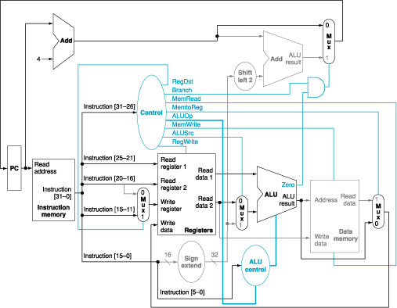
add $t1,$t2,$t3
Single-cycle CPU

Slide 43
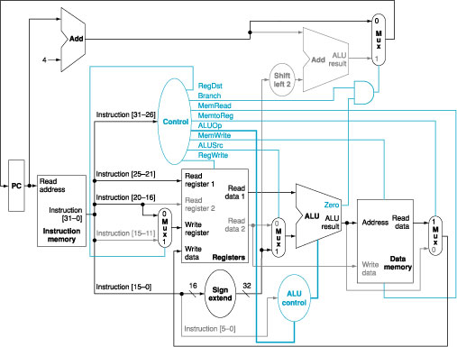
lw $t1,offset($t2)
Single-cycle CPU

Slide 44
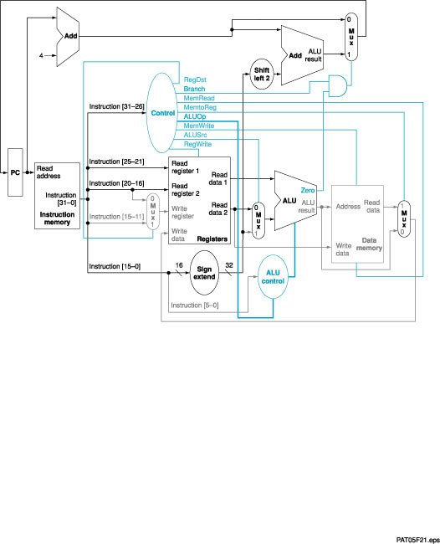
beq $t1,$t2,offset
CS465
Single-cycle CPU

Slide 45
An Abstract View of Critical Path
Register file and ideal memory:
  The CLK input is a factor ONLY during write operation
  During read operation, behave as combinational logic:
    Address valid => Output valid after “access time.”
Critical Path (Load Operation) =
PC’s Clk-to-Q +
Instruction Memory’s Access Time +
Register File’s Access Time +
ALU to Perform a 32-bit Add +
Data Memory Access Time +
Setup Time for Register File Write +
Clock Skew
Ideal
Instruction
Memory
Instruction
Rd
Rs
Rt
Imm
5
5
5
16
Instruction
Address
A
Data
Address
Rw
Ra
Rb
32
32
32
Ideal
Data
Memory
32 32-bit
Registers
ALU
PC
Next Address
Data In
B
Clk
Clk
Clk
32
Single-cycle CPU
Notes:
Now with the clocking methodology back in your mind, we can think about how the critical path of our “abstract” datapath may look like.
One thing to keep in mind about the Register File and Ideal Memory (points to both Instruction and Data) is that the Clock input is a factor ONLY during the write operation.
For read operation, the CLK input is not a factor. The register file and the ideal memory behave as if they are combinational logic.
That is you apply an address to the input, then after certain delay, which we called access time, the output is valid.
We will come back to these points (point to the “behave” bullets) later in this lecture.
But for now, let’s look at this “abstract” datapath’s critical path which occurs when the datapath tries to execute the Load instruction.
The time it takes to execute the load instruction are the sum of:
(a) The PC’s clock-to-Q time.
(b) The instruction memory access time.
(c) The time it takes to read the register file.
(d) The ALU delay in calculating the Data Memory Address.
(e) The time it takes to read the Data Memory.
(f) And finally, the setup time for the register file and clock skew.
+3 = 21 (Y:01)

Slide 46
Single Cycle Implementation
Calculate cycle time assuming negligible delays except:
  memory (2ns), ALU and adders (2ns), register file access (1ns)
P
C
S
r
c
1
A
d
d
M
u
A
L
U
x
4
A
d
d
r
e
s
u
l
t
0
R
e
g
W
r
i
t
e
l
S
h
i
f
t
e
f
t
2
I
n
s
t
r
u
c
t
i
o
n
[
2
5
–
2
1
]
R
e
a
d
P
C
R
e
a
d
r
e
g
i
s
t
e
r
1
d
R
e
a
d
M
e
m
W
r
i
t
e
a
d
d
r
e
s
s
I
n
s
t
r
u
c
t
i
o
n
[
2
0
–
1
6
]
R
e
a
d
a
t
a
1
A
L
U
S
r
c
M
e
m
t
o
R
e
g
I
n
s
t
r
u
c
t
i
o
n
1
r
e
g
i
s
t
e
r
2
R
e
a
d
Z
e
r
o
[
3
1
–
0
]
W
r
i
t
e
d
a
t
a
2
1
A
L
U
r
e
A
L
U
A
d
d
r
e
s
s
R
e
a
d
1
M
r
e
g
i
s
t
e
r
M
s
u
l
t
d
a
t
a
I
n
s
t
r
u
c
t
i
o
n
I
n
s
t
r
u
c
t
i
o
n
[
1
5
–
1
1
]
u
u
M
m
e
m
o
r
y
x
W
r
i
t
e
R
e
g
i
s
t
e
r
s
x
u
0
d
a
t
a
0
D
a
t
a
x
R
e
g
D
s
t
W
r
i
t
e
m
e
m
o
r
y
0
I
n
s
t
r
u
c
t
i
o
n
[
1
5
–
0
]
1
6
S
i
g
n
3
2
d
a
t
a
e
x
t
e
n
d
A
L
U
M
e
m
R
e
a
d
c
o
n
t
r
o
l
I
n
s
t
r
u
c
t
i
o
n
[
5
–
0
]
A
L
U
O
p
Single-cycle CPU

Slide 47
Single Cycle Implementation
Calculate cycle time assuming negligible delays except:
  memory (2ns), ALU and adders (2ns), register file access (1ns)
Instruction class | Instruction Fetch | Register Access | ALU | Register/Memory Access | Register Access
R-Type | X | X | X | R
Load | X | X | X | M | X
Store | X | X | X | M
Branch | X | X | X
Jump | X
Single-cycle CPU

Slide 48
How to Design a Processor
1. Analyze instruction set ⇒ datapath requirements √
2. Select set of datapath components and establish clocking methodology √
3. Assemble datapath meeting the requirements √
4. Analyze implementation of each instruction to determine setting of control points that effects the register transfer
5. Assemble the control logic
Single-cycle CPU

Slide 49
Step 4: Datapath: RTL -> Control
Instruction<31:0>
Inst
Memory
<21:25>
<21:25>
<16:20>
<11:15>
<0:15>
Adr
Op
Fun
Rt
Rs
Rd
Imm16
Control
Branch
RegWr
RegDst
ALUSrc
ALUop
MemRd
MemWr
MemtoReg
Zero
DATA PATH
Single-cycle CPU

Slide 50
Control
Selecting the operations to perform (ALU, read/write, etc.)
  Design the ALU Control Unit
Controlling the flow of data (multiplexor inputs)
  Design the Main Control Unit
Information comes from the 32 bits of the instruction
Example:
add $8, $17, $18 Instruction Format:
000000 10001 10010 01000 00000 100000
op rs rt rd shamt funct
ALU's operation based on instruction type and function code
Single-cycle CPU

Slide 51
ALU Control
What should the ALU do with the given instruction
Example: lw $1, 100($2)
35 2 1 100
op rs rt 16 bit offset
ALU control input
0000 AND
0001 OR
0010 add
0110 subtract
0111 set-on-less-than
Recall design of ALU from Chapter 3
Single-cycle CPU

Slide 52
ALU Control Design
Instruction opcode | ALUOp | Instruction operation | Funct field | Desired ALU action | ALU control input
LW | 00 | Load word | xxxxxx | Add | 0010
SW | 00 | Store word | xxxxxx | Add | 0010
BEQ | 01 | Branch eq | xxxxxx | Subtract | 0110
R-type | 10 | Add | 100000 | Add | 0010
R-type | 10 | Subtract | 100010 | Subtract | 0110
R-type | 10 | AND | 100100 | And | 0000
R-type | 10 | OR | 100101 | Or | 0001
R-type | 10 | Set on less than | 101010 | Set on less than | 0111
Single-cycle CPU

Slide 53
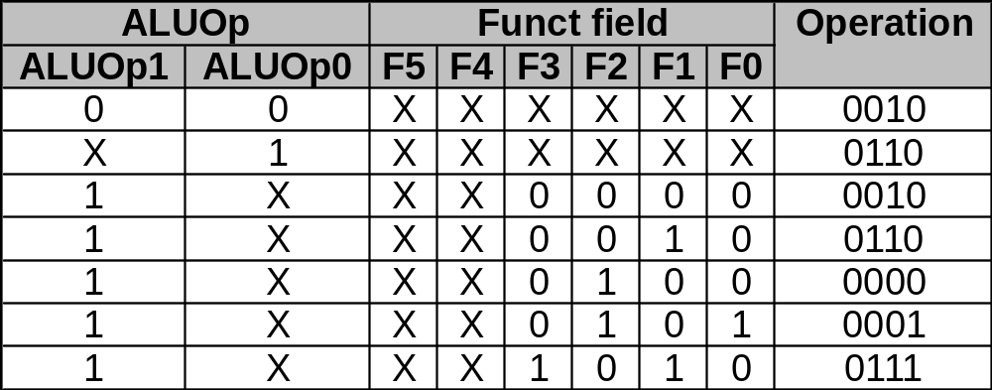
Control Implementation
Must describe hardware to compute 4-bit ALU control input
  Given instruction type
  00 = lw, sw
  01 = beq
  10 = arithmetic
  Function code for arithmetic
Describe it using a truth table (can turn into gates):
ALUOp
computed from instruction type
Single-cycle CPU

Slide 54
Design the Main Control Unit
Seven control signals
RegDst
RegWrite
ALUSrc
PCSrc
MemRead
MemWrite
MemtoReg
Single-cycle CPU

Slide 55
Control Signals
RegDst = 0 => Register destination number for the Write register comes from the rt field (bits 20-16)
RegDst = 1 => Register destination number for the Write register comes from the rd field (bits 15-11)
RegWrite = 1 => The register on the Write register input is written with the data on the Write data input (at the next clock edge)
ALUSrc = 0 => The second ALU operand comes from Read data 2
ALUSrc = 1 => The second ALU operand comes from the sign- extension unit
PCSrc = 0 => The PC is replaced with PC+4
PCSrc = 1 => The PC is replaced with the branch target address
MemtoReg = 0 => The value fed to the register write data input comes from the ALU
MemtoReg = 1 => The value fed to the register write data input comes from the data memory
MemRead = 1 => Read data memory
MemWrite = 1 => Write data memory
Single-cycle CPU

Slide 56
R-format Instructions
RegDst = 1
RegWrite = 1
ALUSrc = 0
Branch = 0
MemtoReg = 0
MemRead = 0
MemWrite = 0
ALUOp = 10
Single-cycle CPU

Slide 57
Memory Access Instructions
Load word
Store Word
RegDst = 0
RegWrite = 1
ALUSrc = 1
Branch = 0
MemtoReg = 1
MemRead = 1
MemWrite = 0
ALUOp = 00
RegDst = X
RegWrite = 0
ALUSrc = 1
Branch = 0
MemtoReg = X
MemRead = 0
MemWrite = 1
ALUOp = 00
Single-cycle CPU

Slide 58
Branch on Equal
RegDst = X
RegWrite = 0
ALUSrc = 0
Branch = 1
MemtoReg = X
MemRead = 0
MemWrite = 0
ALUOp = 01
Single-cycle CPU

Slide 59
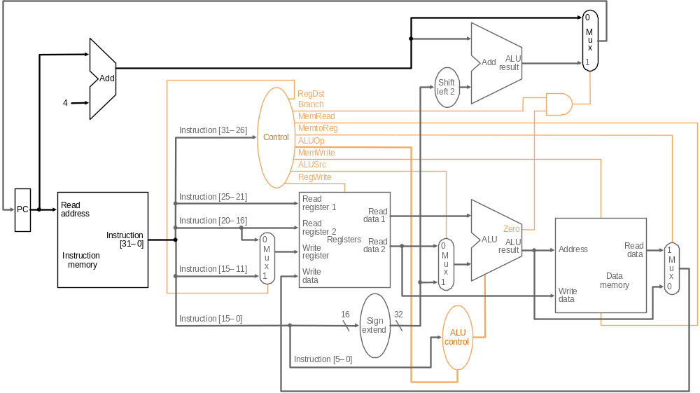
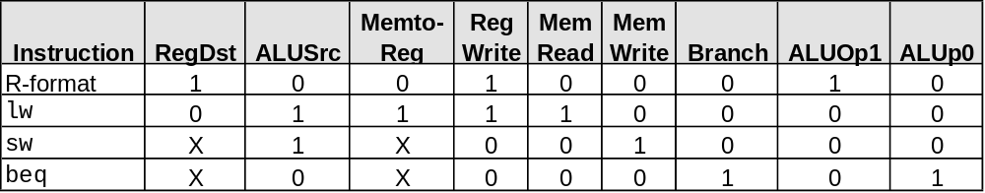
Control
Single-cycle CPU

Slide 60
Step 5: Implementing Control
Simple combinational logic (truth tables)
I
n
p
u
t
s
O
p
5
O
p
4
O
p
3
O
p
2
A
L
U
O
p
O
p
1
A
L
U
c
o
n
t
r
o
l
b
l
o
c
k
O
p
0
A
L
U
O
p
0
A
L
U
O
p
1
O
u
t
p
u
t
s
R
-
f
o
r
m
a
t
I
w
s
w
b
e
q
R
e
g
D
s
t
F
3
O
p
e
r
a
t
i
o
n
2
A
L
U
S
r
c
F
2
O
p
e
r
a
t
i
o
n
M
e
m
t
o
R
e
g
F
(
5
–
0
)
O
p
e
r
a
t
i
o
n
1
R
e
g
W
r
i
t
e
F
1
O
p
e
r
a
t
i
o
n
0
M
e
m
R
e
a
d
F
0
M
e
m
W
r
i
t
e
B
r
a
n
c
h
A
L
U
O
p
1
ALU Control Unit
A
L
U
O
p
O
Main Control Unit
Single-cycle CPU

Slide 61
Our Simple Control Structure
All of the logic is combinational
We wait for everything to settle down, and the right thing to be done
  ALU might not produce “right answer” right away
  We use write signals along with clock to determine when to write
Cycle time determined by length of the longest path
S
t
a
t
e
S
t
a
t
e
e
l
e
m
e
n
t
C
o
m
b
i
n
a
t
i
o
n
a
l
l
o
g
i
c
e
l
e
m
e
n
t
1
2
C
l
o
c
k
c
y
c
l
e
Single-cycle CPU

Slide 62
Summary
5 steps to design a processor
  1. Analyze instruction set => datapath requirements
  2. Select set of datapath components & establish clock methodology
  3. Assemble datapath meeting the requirements
  4. Analyze implementation of each instruction to determine setting of control points that effects the register transfer
  5. Assemble the control logic
MIPS makes it easier
  Instructions same size
  Source registers always in same place
  Immediates same size, location
  Operations always on registers/immediates
Single cycle datapath => CPI=1, Clock Cycle Time => long
Single-cycle CPU

Slide 63
Next Lecture
Topic:
  Multiple cycle implementation of CPU
Reading
  Ch5 Patterson and Hennessy
Single-cycle CPU

